Slide 1


Slide 2

Major Project – II (01CE0807)
Review 1 (13/01/2024)
Learn Sync – Your Learning Companion
Team ID: MU_CE_2023-24_126
Team Member 1: Aum Pitroda (92000103148) (TC3)
Team Member 2: Ravi Ajagiya (92000103139) (TC2)
Team Member 3: Kishan Songara (92000103090) (TC2)
Guided By
Internal Guide Name: Prof. Santushti Bergeri
Department of Computer Engineering, Faculty of Technology

Slide 3
Outline
1.0 Introduction to Project and Project Management
1.1 Project Summary
1.2 Purpose
1.3 Objective
1.4 Scope
1.5 Technology & Literature Review
1.6 Project Planning
2.0 System Analysis
2.1 Study of Current System
2.2 Features of LearnSync
2.3 Components of LearnSync
3.0 System Design
3.1 System Design & Methodology
3.2 Database Design
3.3 User Flow Diagram

Slide 4

Introduction to Learn Sync
Our Team’s Moto :
Be Precise, on time, just meaningful!

Slide 5

Introduction to Learn Sync
LearnSync: Revolutionizing learning with
Advanced Techniques
Gamified Journeys
All-in-one hub
Connected Community
for excellence…

Slide 6

Purpose Behind LearnSync
In the exam's embrace, challenges dance, testing resilience's elegant stance.
Vast Syllabus
Time-Bound Revision
Motivation Hurdles

Slide 7

Objectives of LearnSync
Empowering Aspirants: Equip aspirants to conquer competitive exams, overcoming challenges with Learn Sync's innovative approach.
UI Excellence: Craft a sleek UI for Learn Sync, balancing aesthetics and utility seamlessly for user satisfaction.
Cost-Free Advantage: Provide Learn Sync as a cost-free gem, standing against market competitors, making learning accessible to all.
Accessible, Usable, Scalable: Design Learn Sync for easy access, usability, and scalable adaptability, meeting diverse learning needs effortlessly.
Streak-Based Motivation: Introduce Learn Sync's streak-based approach, turning challenges into achievements, fueling continuous motivation for users.

Slide 8

Scope of LearnSync
Optimize Learning Schedules: Efficiently plan studies with Spaced Repetition, Task, and Time Schedulers.
Enhance Focus with Pomodoro Timer: Boost productivity using Pomodoro Timer for focused study intervals.
Motivate Through Streaks: Instill motivation with Task Streaks, fostering a consistent learning rhythm.
Build Collaborative Communities: Foster connections through Friend's Activity Panel, Group Streaks, and Leaderboards.
Organize Information with Flash Cards: Facilitate effective learning through Flash Cards, promoting information retention.

Slide 9

Literature Review
How to Study Effectively Article, National Library of Medicine–
[“https://www.ncbi.nlm.nih.gov/pmc/articles/PMC5673147/#”]
UI Design and Specification
[https://m3.material.io/]
Dopamine Nation: Finding Balance in the Age of Indulgence – Anna Lembke, American Psychiatrist
insights on processing of pain and pleasure by brain
Research on “Snapchat Streaks: How Adolescents Metagame Gamification in Social Media” by Europe PMC - [“https://europepmc.org/article/ppr/ppr324038”]
Using Gamification in Education: A Systematic Literature Review, Research Gate Article – [“https://www.researchgate.net/publication/330093575_Using_Gamification_in_Education_A_Systematic_Literature_Review”]

Slide 10

Project Planning for LearnSync – Agile Methodology
Agile Scrum is a flexible project management framework emphasizing collaboration, iterative progress in short sprints, and continuous improvement, providing adaptability for changing requirements and efficient team communication.
Why Agile -> SCRUM? Scrum is ideal for LearnSync's small team of three, ensuring clear roles, close collaboration, and efficient task distribution.
Sprint | Start Date | End Date | Goals/Tasks
Sprint 1 | 13/01/2024 | 26/01/2024 | UI Design
Sprint 2 | 27/01/2024 | 09/02/2024 | Backend Functions
Sprint 3 | 10/02/2024 | 23/02/2024 | Database & API Integration
Sprint 4 | 24/02/2024 | 02/03/2024 | Refinements & Additional Features

Slide 11
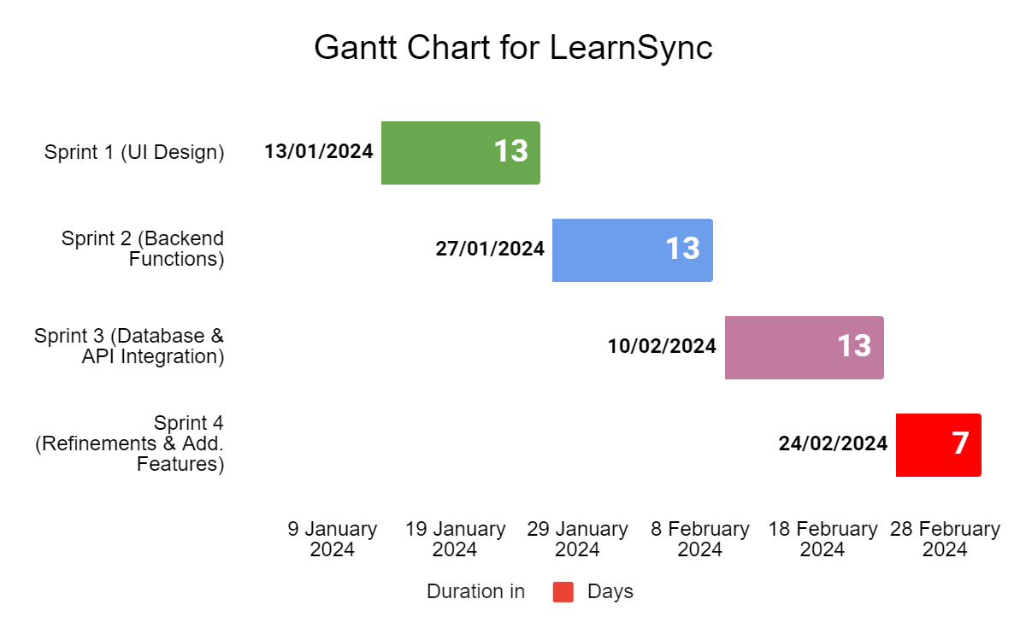
Gantt Chart for LearnSync

Slide 12
1. Study of Current Systems their Major Problems & Weaknesses 2. Requirements of New System
Fragmentation hampers seamless learning, requiring navigation across multiple scattered tools.
Unified Platform: Integrate various tools into a cohesive, unified learning platform.
Gamification lacks immersion, missing opportunities for a motivating learning experience.
Immersive Gamification: Implement engaging and motivating gamification for a truly immersive experience.
Overlooked techniques like spaced repetition limit memory retention enhancement .
Comprehensive Techniques: Prioritize memory enhancement techniques in to design.
Social platforms lack the warmth of a real community for learning.
Vibrant Community Integration: Foster a warm and vibrant community atmosphere for collaborative learning.
Some tools suffer from unfriendly user interfaces, hindering the learning journey.
Sleek User Interface: Design a modern and user-friendly interface for a smooth learning journey.

Slide 13
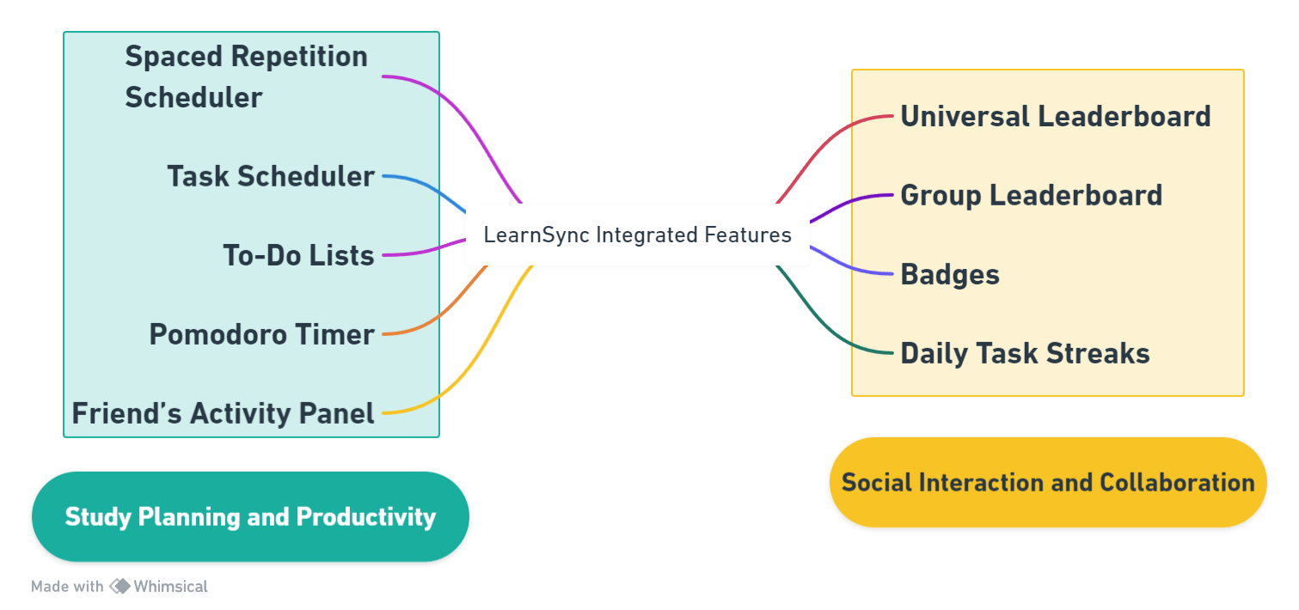
Features of LearnSync : Activities + Easy Integration with Native Tools

Slide 14
Components of LearnSync (Overview of Modules / Pages)
Introduction & Support | User Interactions | Social Interaction | User Account
Home/Welcome Page | Dashboard | Friend's Activity Panel | Profile
Login/Registration | Modules Accessible on Dashboard Study Planning Spaced Repetition Scheduler Task Scheduler To-Do Lists Pomodoro Timer Links to Other Pages | Domain Leaderboard | Integration
About Us | Spaced Repetition ... | Group Leaderboard | Leaderboard
FAQs | Task Scheduler | Badges | Streaks and Challenges
Privacy Policy | To-Do Lists | Daily Tasks Streaks | Settings
 | Pomodoro Timer | Group + Task Streaks | Error Pages

Slide 15
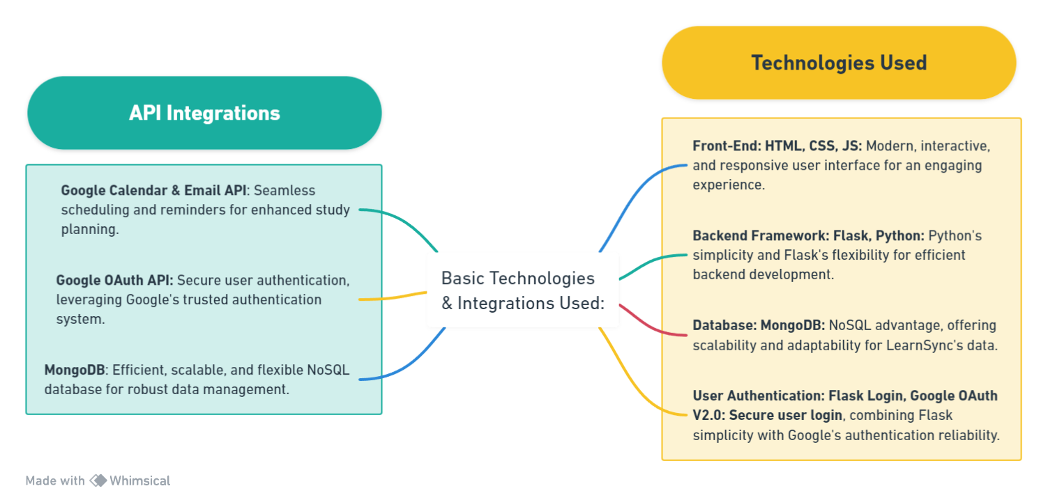
System Design : Web Based Methodologies

Slide 16
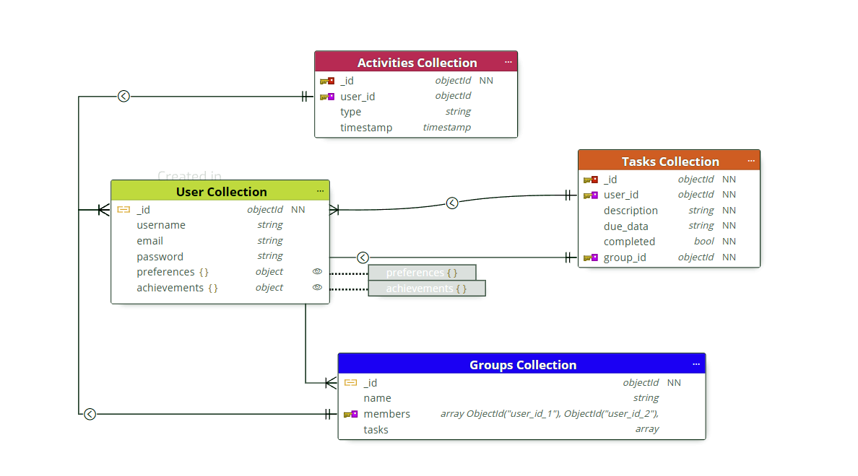

No-SQL Database : MongoDB Design For LearnSync

Slide 17
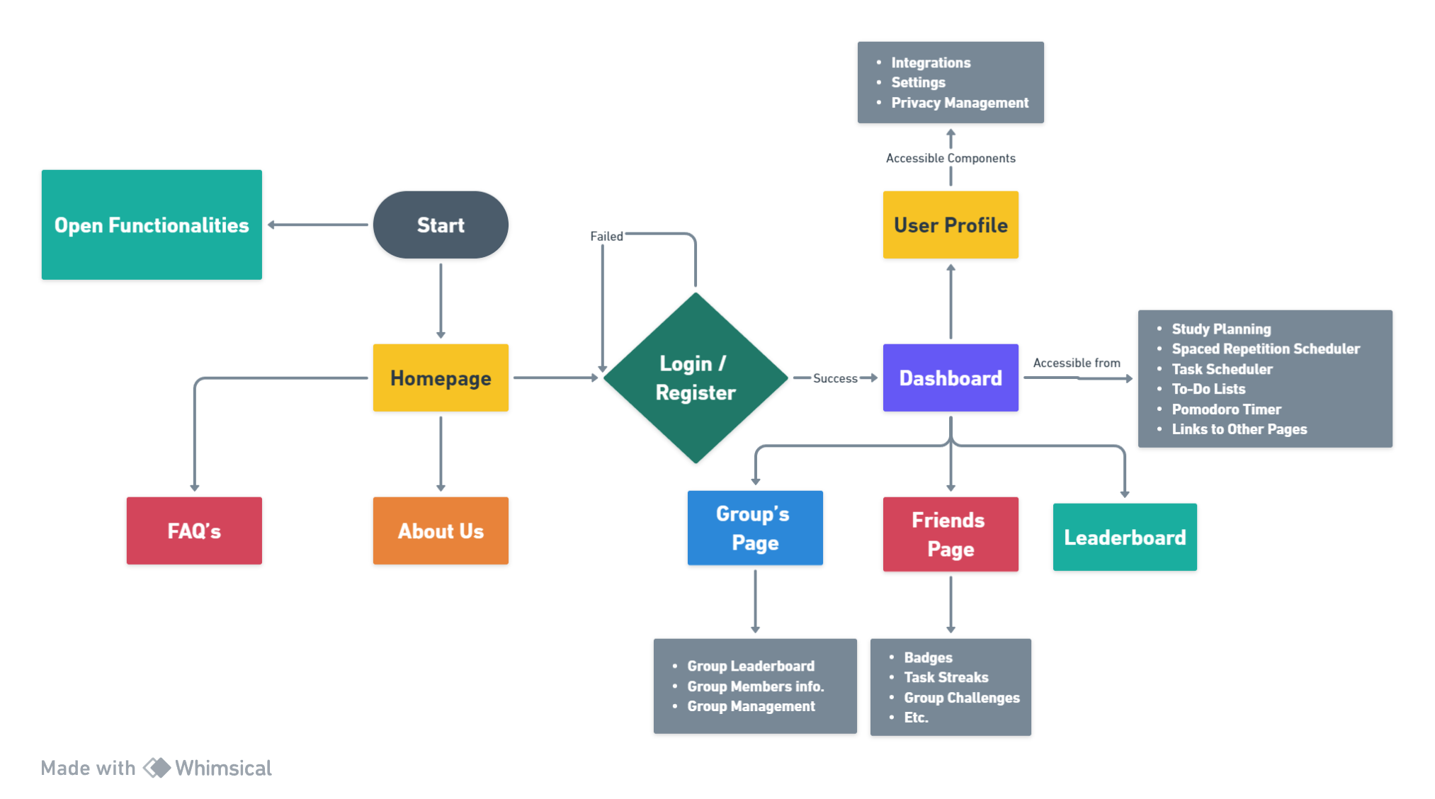
User Flow Diagram for LearnSync Basic

Slide 18
Introduction to Learn Sync
LearnSync: Revolutionizing learning with advanced techniques, gamified journeys, all-in-one hub, and a connected community for excellence.

Slide 19
Introduction to Learn Sync
LearnSync: Revolutionizing learning with advanced techniques, gamified journeys, all-in-one hub, and a connected community for excellence.

Slide 20
Introduction to Learn Sync
LearnSync: Revolutionizing learning with advanced techniques, gamified journeys, all-in-one hub, and a connected community for excellence.

Slide 21


